Slide 1
ALPHA ENTERPRISES
A corporate launch from BETA INTERNATIONAL

Slide 2
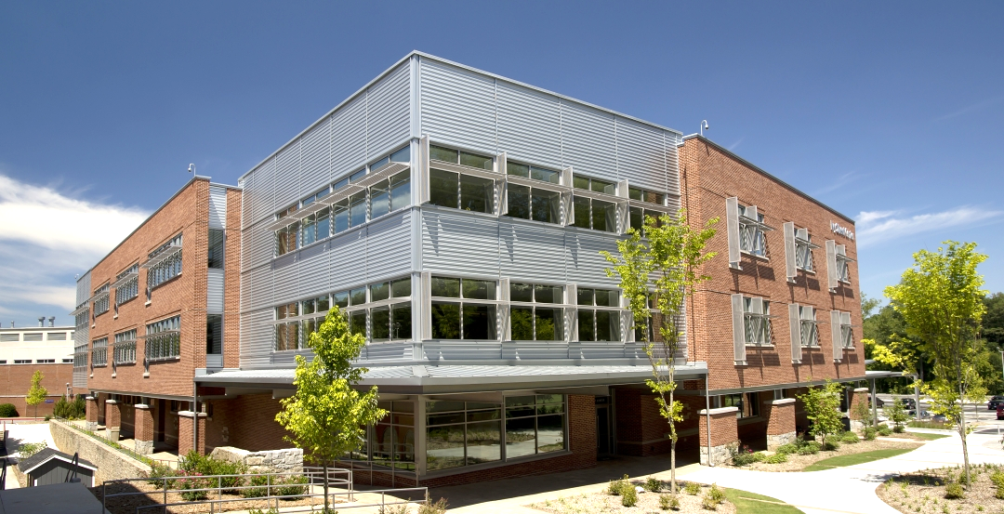
Systems plan for LA Office with room to grow
Summary Network 192.168.0.0/16
LA Block /18, OC and SD Blocks, /18
ALPHA.COM’s new main office will be located in Los Angeles. The network is planned to leave room for additional branch office openings in Orange County and San Diego at a later date. The building spans 3 floors with a current employee count of 150. There are 20 printers for each floor. Each office has a computer and voip phone. There are currently 40 offices to each floor, a main reception desk on the 1st floor and a small datacenter in the basement.
1st Fl | 192.168.1.0/24
2nd Fl | 192.168.2.0/24
3rd Fl | 192.168.3.0/24
Datacenter | 192.168.16.0./24
Routers | 192.168.30.0/28
MNGT | 192.168.99.0/28
DMZ | 172.16.1.0/24
Public IPS | 1.1.1.0/28

Slide 3
VLANS extend the network, separate and reduce the broadcast domains.
VOICE | VLAN 310, 210 ,110
DATA | VLAN 320, 220, 120
PRINT | VLAN 330, 230, 130
EXEC | VLAN 340
ACCT | VLAN 240
IT | VLAN 140
MNGT | VLAN 99
SERVICE | VLAN 10
NATIVE | VLAN 99
DHCP | 192.168.1,2,3.2-62
DHCP | 192.168.1,2,3.66-126
Static | 192.168.1,2,3.130-190
DHCP | 192.168.3.194-205
DHCP | 192.168.2.194-215
DHCP | 192.168.1.194-205
Static | 192.168.31.1-6
Static | 192.168.16.10-30
DEFAULT | VLAN 1 is disabled

Slide 4
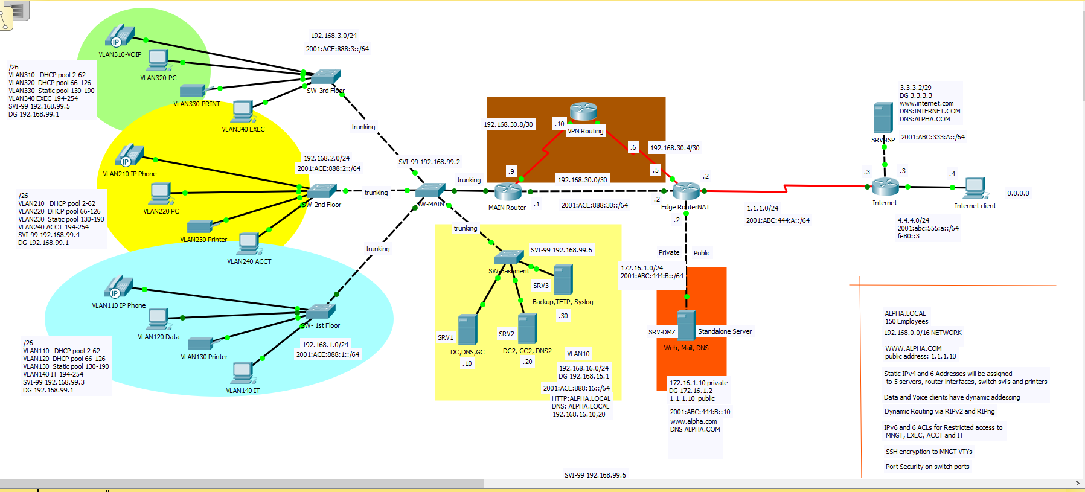
Topology for LA Main Office- Balanced Distribution, Availability and Security

Slide 5
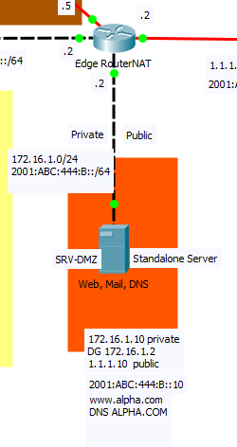
DMZ zone separates public and private traffic.
The edge router performs NAT translation at the edge of the company LAN to allow public traffic to access a standalone server that provides the public company HTTPS, mail and DNS services. ALPHA Enterprise has purchased a 16 address public IP block for its VPN, firewall and private security services as well as its ADFS, web mail and cloud-share services.

Slide 6
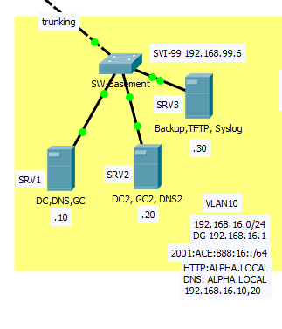
ACL lists provides secure network access to select services and devices ACL lists for IPv4 and 6 (1 and MNGT) allow IT group to access router VTY config lines by SSH ACL list NA denies traffic to EXEC devices from 1st and 2nd floors with the exception of IT and ACCT groups. ACL list ACCT-NA denies traffic to ACCT from 3rd and 1st floors with the exception of EXEC and IT groups
Special access groups with privileged confidential information or security targets such as Active Directory DCs and Backup Servers will have network protection placed within the routing path so that only certain source traffic is allowed.

Slide 7
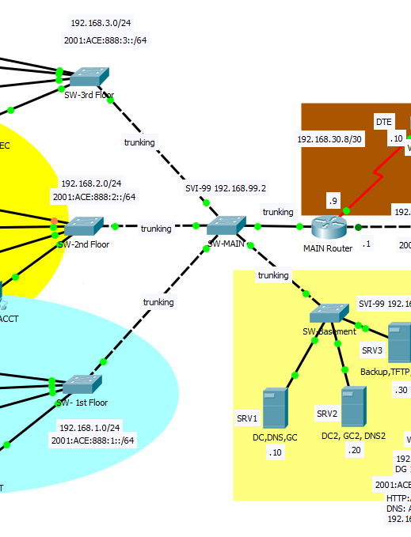
Dynamic Routing for IPv4 and IPv6 across the network
RIPv2 and RIPng are implemented in this small scale network. Because of the diverse type of network devices that the company is utilizing, EIGRP was not an option. OSPF would be recommended once the number of routers reaches 14.

Slide 8
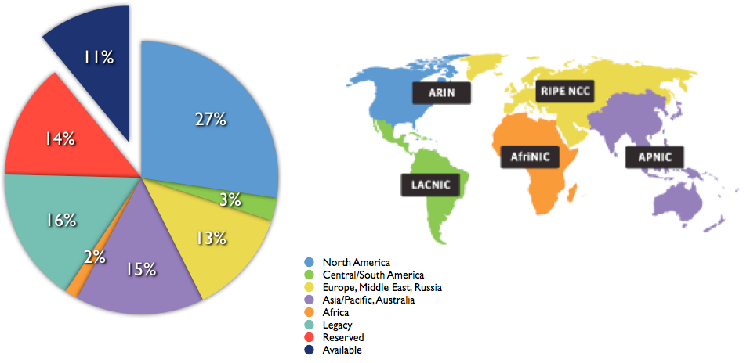
Investing in the future of IPv6
IPv4 address allocation as of 2017
IPv6 transition technology is helping to bring connectivity to more people
ALPHA.COM's parent company BETA INTERNATIONAL is proud of its global distribution supply and forward thinking vision. The company is implementing IPV6 network connectivity along with its IPV4 network in the US with all new IPV6 equipment. They believe that now is the right time to make an investment for the future.

Slide 9
IPv6 SLAAC Dynamic Addressing for clients and Static Addressing for Servers, Routers and Printers
Summary | 2001:ACE:888::/48
1st Fl | 2001:ACE:888:1::/64
2nd Fl | 2001:ACE:888:2::/64
3rd Fl | 2001:ACE:888:3::/64
SRV1 | 2001:ACE:888:16::10
SRV2 | 2001:ACE:888:16::20
SRV3 | 2001:ACE:888:16::30
DMZ | 2001:ACE:888:16::40
MAIN Route | 2001:ACE:888:30::/126
Print 1st Fl | 2001:ACE:888:1::130-150
Print 2nd Fl | 2001:ACE:888:2::130-150
Print 3rd Fl | 2001:ACE:888:3::130-150
The VPN route will be using Direct Access SSTP 6 to 4 routing. IPv6 addresses are dynamically assigned via the Direct Access DNS server. A static IPv4 network is configured before Direct Access will be implemented. For now, the route serves as a static floating route that provides availability should the main route be inaccessible.

Slide 10
A final note ending on security:
In addition to network design and policies, local safeguards on physical devices prevent tampering and remote intrusion.
Switches and routers are protected with individual device security (SSH, port security, management ACL, strong enable password encryption, local username database with strong password encryption)
A network that is built to serve its company will provide high availability along with secure protection of its most valuable assets. Secondarily but also an important priority is to keep a clean, simple well-organized system and network that makes it easy to implement changes in policy or scale and to adapt with changing technologies.

